Slide 1
Differential Cryptanalysis -DES
The intruder concentrates on chosen-plaintext attacks.
The analysis uses the propagation of input differences through the cipher.
The term ‘difference’ here refers to exclusive-OR of two different inputs(plain texts).
Intruder analyzes how P ⊕ P’ is propagated through rounds.

Slide 2
Differential Cryptanalysis
Probabilistic Relations
The idea of differential cryptanalysis is based on the probabilistic relations between input and output differences.
Two relations are of particular interest in the analysis: Differential profiles and round characteristics

Slide 3
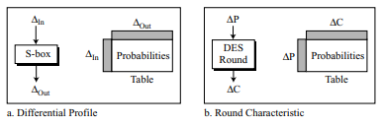
Differential Profile
Fig1

Slide 4
Differential Cryptanalysis
Differential Profile
A differential profile (or XOR profile) shows the probabilistic relation between the input differences and output differences of an S-box.

Slide 5
Differential Cryptanalysis
Round Characteristic
A round characteristic is similar to a differential profile but calculated for the whole round.
The characteristic shows the probability that one input difference would create one output difference.
Note: The characteristic is same for each round because any relation that involves differences is independent of the round key.

Slide 6
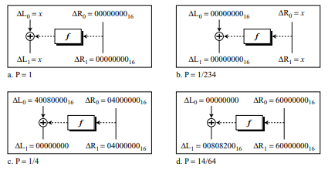
Differential Cryptanalysis
Round characteristic
There are many round characteristics for a round but figure below shows only 4 of them.
Fig 2

Slide 7
Differential Cryptanalysis
In each characteristic there is division of input differences and output differences into left and right sections.
Each left or right difference is made of 32 bits or 8 hexadecimal digits.
Fig a shows that the input difference of (x,00000000₁₆) produces the output difference of (x,00000000₁₆) with probability 1.

Slide 8
Differential Cryptanalysis
Fig b shows the same characteristic as Fig a except that the left and right inputs and outputs are swapped; the probability will change tremendously.
Fig c shows that the input difference of (40080000₁₆,04000000₁₆) produces the output difference (00000000₁₆,04000000₁₆) with probability ¼.
Fig d shows that the input difference (00000000₁₆,60000000₁₆) produces the output difference (00808200₁₆,60000000₁₆) with probability 14/64.

Slide 9
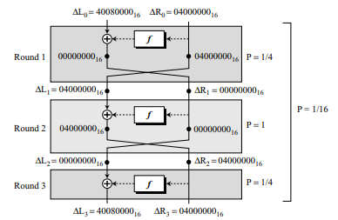
Differential Cryptanalysis
A Three-Round Characteristic
The analyzer can combine different rounds to create a multiple-round characteristic.
Fig 3

Slide 10
Differential Cryptanalysis
In this Fig there are 3 mixers and only 2 swappers because the last round needs no swapper.
The characteristics shown in the mixers of the 1st and 3rd rounds is same as of Fig 2.
The characteristic of the mixer in 2nd round is same as the one in Fig 1.
In this particular case the input and output differences are the same(∆L₃= ∆L₀ and ∆R₃= ∆R₀)

Slide 11
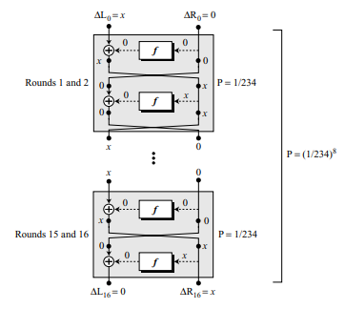
Differential Cryptanalysis
Fig 4

Slide 12
Differential Cryptanalysis
Attack
Assume that Eve uses the characteristic of Fig 4 to attack a 16- round DES. Eve somehow lures Alice to encrypt a lot of plaintexts in the form (x,0), in which the left half is x(different values) and right half is 0. Eve then keeps all cipher texts received from Alice in the form (0,x).
Note: 0 means 00000000₁₆

Slide 13
Differential Cryptanalysis
Finding the Cipher Key
By finding the round keys from the bottom to the top(K₁₆ to K₁)
Finding the last Round key: If the intruder has enough plaintext/ciphertext pairs she can use the relationship in the last round, 0=f(K₁₆ ,x) to find some of the bits in K₁₆ .This can be done by finding the most probable values that make this relation more likely.

Slide 14
Differential Cryptanalysis
Finding other round keys
Can be found using other characteristics or brute-force attacks.
Security
2⁴⁷ Chosen plaintext/ciphertext pairs are needed to attack a 16-round DES. Finding such a huge no. of pairs is difficult so DES is not vulnerable to this type of attack.

Slide 15
Linear Cryptanalysis
It is a known-plaintext attack
The analysis uses the propagation of a particular set of bits through the cipher.
Linearity Relations
Linear Cryptanalysis is based on linearity relations. Two set of relations particularly: linear profile and round characteristics.

Slide 16
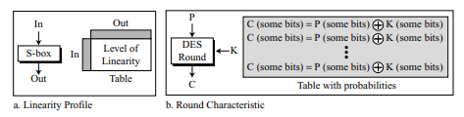
Linear Cryptanalysis
Fig 5

Slide 17
Linear Cryptanalysis
Linear Profile
A linear profile shows the level of linearity between input and output of an S-box. In an S-box, each output bit is a function of all input bits.
The ideal case in an S-box is if each output bit is a non-linear function of all input bits. Unfortunately some output bits are linear function of some combinations of input bits.

Slide 18
Linear Cryptanalysis
The cryptanalysis can create 8 different tables, one for each S-box, in which the 1st column shows the possible combination of 6-bit inputs, 00₁₆ to 3F₁₆ and the 1st row shows the possible combinations of 4-bit inputs, 0₁₆ to F₁₆ . The entries show the level of linearity.

Slide 19
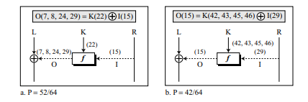
Linear Cryptanalysis
Round Characteristic
Shows the combination of input bits, round key bits, and output bits that show a linear relation.
Fig 6 shows two different round characteristics.
Fig 6

Slide 20
Linear Cryptanalysis
The notation used for each case defines the bits that must be exclusive-ored together.
For example, O(7, 8, 24, 29) means the exclusive-or of 7th, 8th, 24th, and 29th bits coming out of the function;
K(22) means the 22nd bit in the round key; I(15) means the 15th bit going into the function.

Slide 21
Linear Cryptanalysis
The relations using individual bits :
Part a: O(7) ⊕ O(8) ⊕ O(24) ⊕ O(29) = I(15) ⊕ K(22)
Part b: F(15) = I(29) ⊕ K(42) ⊕ K(43) ⊕ K(45) ⊕ K(46)

Slide 22
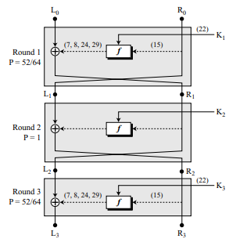
Linear Cryptanalysis
A Three-Round Characteristic
Fig 7 shows a case of a three-round DES in which rounds 1 and 3 use the same characteristic as shown in Fig 6, but round 2 uses an arbitrary characteristic.
Fig 7

Slide 23
Linear Cryptanalysis
The goal of linear cryptanalysis is to find a linear relation between some bits in the plaintext, the ciphertext, and the key
For Fig 7
Round 1: R₁(7, 8, 24, 29) = L₀(7, 8, 24, 29) ⊕ R₀(15) ⊕ K₁(22)
Round 3: L₃(7, 8, 24, 29) = L₂(7, 8, 24, 29) ⊕ R₂(15) ⊕ K₃(22)

Slide 24
Linear Cryptanalysis
But L₂ is the same as R₁, and R₂ is the same as R₃. After replacing L₂ with R₁ and R₂ with R₃ in the second relation, we have:
L₃(7, 8, 24, 29) = R₁(7, 8, 24, 29) ⊕ R₃ (15) ⊕ K₃(22)
Substitute R₁ with its equivalent value in round 1, resulting in:
L₃(7, 8, 24, 29) = L₀(7, 8, 24, 29) ⊕ R₀(15) ⊕ K₁(22) ⊕ R₃ (15) ⊕ K₃(22)

Slide 25
Linear Cryptanalysis
This is a relationship between input and output bits for the whole three rounds after being reordered:
L₃(7, 8, 24, 29) ⊕ R₃(15) = L₀(7, 8, 24, 29) ⊕ R₀(15) ⊕ K₁(22) ⊕ K₃(22)
In other words, we have:
C(7, 8, 15, 24, 29) = P(7, 8, 15, 24, 29) ⊕ K₁(22) ⊕ K₃(22)

Slide 26
Linear Cryptanalysis
A Sixteen-Round Characteristic
A 16-round characteristic can also be compiled to provide a linear relationship between some plaintext bits, some ciphertext bits, and some bits in the round keys.
C(some bits) = P(some bits) ⊕ K₁(some bits) ⊕ … ⊕ K₁₆(some bits)

Slide 27
Linear Cryptanalysis
Attack
After finding and storing many relationship between some plaintext bits, ciphertext bits, and round-key bits. Eve can access some plaintext/ciphertext pairs (known-plaintext attack) and use the corresponding bits in the stored characteristics to find bits in the round keys.

Slide 28
Linear Cryptanalysis
Security
243 known plaintext/ciphertext pairs are needed to attack a 16-round DES.
Linear cryptanalysis looks more probable than differential cryptanalysis for two reasons.
First, the number of steps is smaller.
Second it is easier to launch a known plaintext attack than a chosen-plaintext attack.

